Slide 1

Course Code : SCSA1303
Course Name : Software Engineering
Sathyabama Institute of Science and Technology

Slide 2
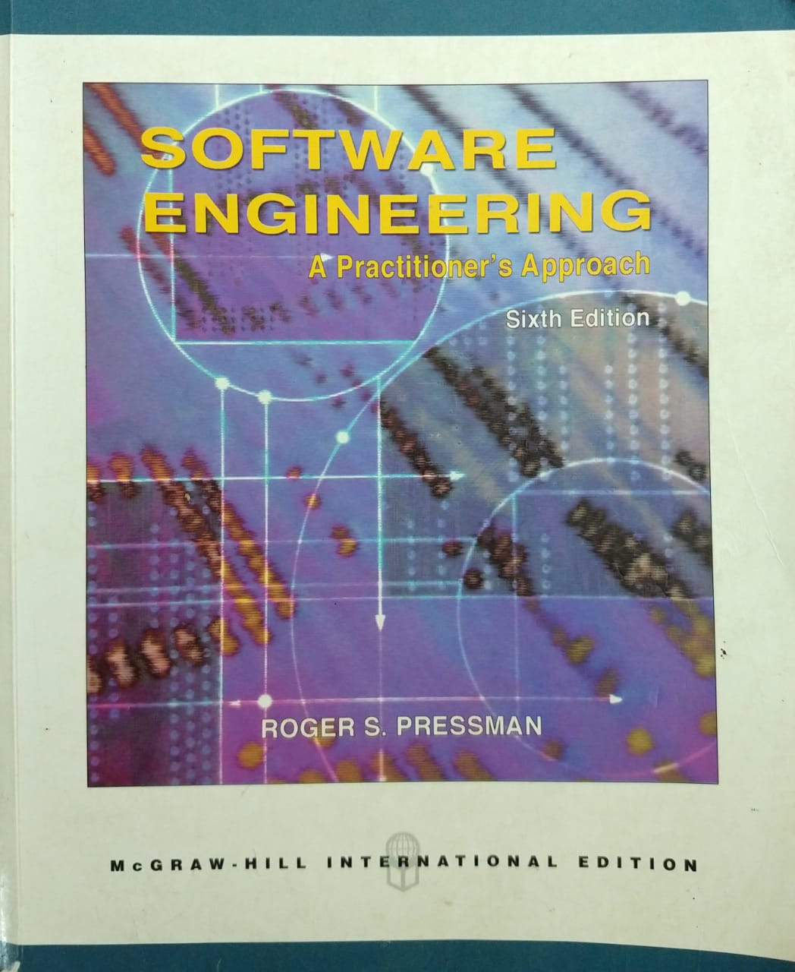

Slide 3
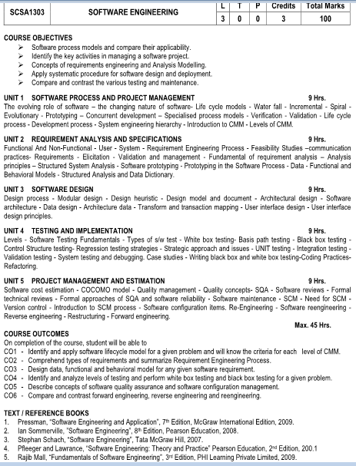

Slide 4
SCSA1303 : SOFTWARE ENGINEERING
UNIT 1 : Software Process & Project Management
UNIT 2 : Requirement Analysis & Specifications
UNIT 3 : Software Design
UNIT 4 : Testing & Implementation
UNIT 5 : Project Management & Estimation

Slide 5
Software Engineering Course Objective ( CO)
Software Process Models and Compare their Applicability
Identify the Key Activities in Managing a Software Project
Concepts of Requirements Engineering and Analysis Modelling
Apply Systematic Procedure for Software Design and Deployment
Compare and Contrast the Various Testing and Maintenance Activities

Slide 6
Unit 1 : Software Process and Project Management
The Evolving Role of Software
The Changing Nature of Software
Life Cycle Models
Evolutionary Model
Prototyping Model
Concurrent Development Model
Specialised Process Models
Process
System Engineering Hierarchy
Introduction to CMM

Slide 7
Course Outcome – Unit 1
CO1 :
1) Identify and Apply Software Life
Cycle Model for a given Problem
2) Will Know the Criteria for Each
Level of CMM

Slide 8
What is Software?
Software is:
Instructions (Computer Programs) that when executed provide desired features, function, and performance
(2) Data Structures that enable the programs to adequately manipulate information
(3) Documentation that describes the operation and use of the programs.
Notes:
Polya suggests:
1. Understand the problem (communication and analysis).
2. Plan a solution (modeling and software design).
3. Carry out the plan (code generation).
4. Examine the result for accuracy (testing and quality assurance)

Slide 9
Types of Software
System Software
Includes Programs that are dedicated to Manage the Computer itself
Operating System ( Compliers, Assemblers..)
Driver Software( Printer Driver , USB Driver..)
Utility Software ( Avast AntiVirus , WinZip, Disk Cleaner)
Application Software
- Stand - alone programs for Specific Needs
Database Software ( MSAccess , FoxPro, MySQL)
Multimedia Software ( Adobe , VLC Media Player)

Slide 10
What is Engineering?
Engineering is a Branch of Science and Technology concerned with the use of Scientific Principles to Design and Build Machines, Structures, and other items including Bridges, Tunnels, Roads, Vehicles, Tools, Processes and Computers.
Engineering is the application of Science and Math to Solve Problems

Slide 11
Software Engineering
Software Engineering is the Systematic Application of Engineering Approaches to the Development of Software.
Software Engineering is a Branch of Computer Science.

Slide 12
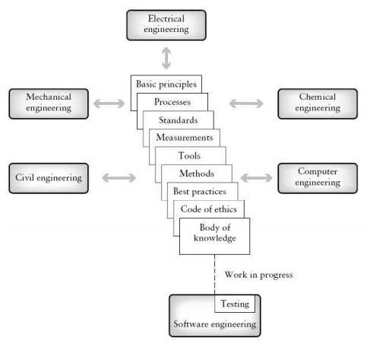
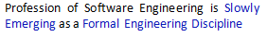
Elements of an Engineering Discipline

Slide 13
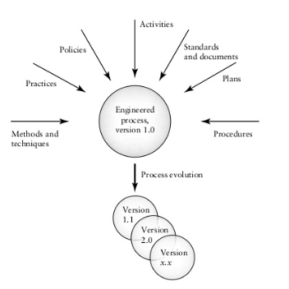
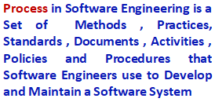
Components of Engineered Process

Slide 14
Objective of Software Engineering
Satisfy Customer Requirements
Product Built within Time ( Time – to – Market )
Product Built within Budget
Product Free from Bugs
Product Developed should be of Highest Quality Satisfying all Quality Attributes like Reliability, Usability , Scalability and Portability.

Slide 15
Software Engineering
Question | Answer
What is Software? | Computer programs, data structures and associated documentation. Software products may be developed for a particular customer or may be developed for a general market.
What are the Attributes of Good Software? | Good software should deliver the required functionality and performance to the user and should be maintainable, dependable and usable.
What is Software Engineering? | Software Engineering is an engineering discipline that is concerned with all aspects of software production.
What is the difference between Software Engineering and Computer Science? | Computer science focuses on theory and fundamentals; software engineering is concerned with the practicalities of developing and delivering useful software.
What is the difference between Software Engineering and System Engineering? | System Engineering is concerned with all aspects of computer-based systems development including Hardware, Software and Process Engineering. Software Engineering is part of the general engineering process .

Slide 16
Essential Attributes of Good Software
Product characteristic | Description
Maintainability | Software should be written in such a way so that it can evolve to meet the changing needs of customers. This is a critical attribute because software change is an inevitable requirement of a changing business environment.
Dependability and Security | Software dependability includes a range of characteristics including reliability, security and safety.
Efficiency | Software should not make wasteful use of system resources such as memory and processor cycles. Efficiency therefore includes responsiveness, processing time, memory utilisation, etc.
Acceptability | Software must be acceptable to the type of users for which it is designed. This means that it must be understandable, usable and compatible with other systems that they use.

Slide 17

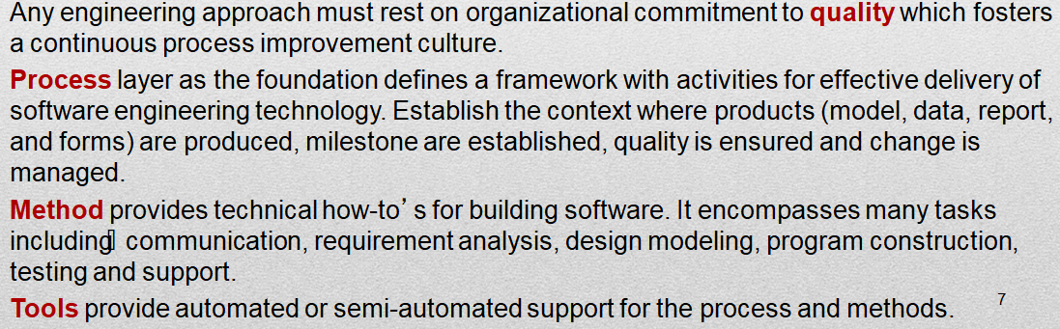
Software Engineering - A Layered Technology

Slide 18
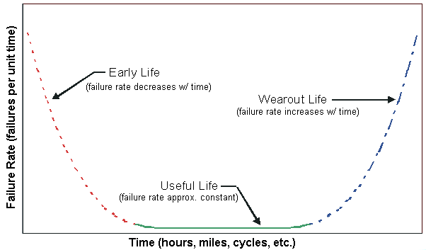
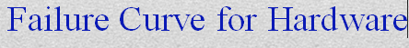
Characteristics of Software
Software is Developed or Engineered, it is not Manufactured
Software doesn't ‘Wear Out’ , but it Deteriorates (due to change). Hardware has BathTub Curve of Failure Rate
- Hardware exhibits High Failure Rate early in its Life,
- Defects are Corrected and Failure Rate Drops to Steady State level for
some period of time,
- Failure Rate Raises again as Hardware Components suffer from
cumulative effects of Dust, Vibration, Temperature occurs).

Slide 19
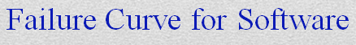
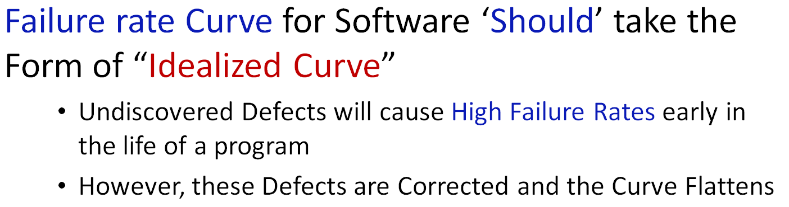
Failure Curve for Software

Slide 20
Failure Curve for Software
“Actual Curve”
During its Life, Software will undergo Change
As Changes are made , it is likely that Errors will be introduced , causing the Failure Rate Curve to spike
Minimum Failure Rate level begins to Rise - Software is Deteriorating due to Change

Slide 21

Software Myths
Myths – Reasonable Statements of Fact / Truth
Belief’s about Software & Process used to Build Software
Software Development Myths.
Pressman (1997) describes a Number of Common Beliefs or Myths that Software Managers, Customers, and Developers believe falsely. He describes these myths as ``Misleading Attitudes that have caused serious problems.
Management Myth’s
Customer Myth’s
Practitioners / Developers Myth’s

Slide 22
Management Myth
If we get behind schedule , we can add more Programmers for fast Software Development ( Mongolian Horde Concept )
We already have a book that’s full of Standards and Procedures for building software. Won’t that provide my people with everything they need to know ?
If i decide to outsource the software project to a third party , i can just relax and let that firm bulid it.
There is No Need to change the Approach to Software Development , we can develop the same software that we developed some 10 years ago

Slide 23
Customer Myth
A General Statement of Objective is Sufficient to begin writing program - No Need to mention the details.we can fill in details later
Project Requirement continually changes , but can be easily accommodated easily because software is Flexible.

Slide 24

Practitioner Level / Developer Myth
Once we write Program and get it work, Job is Done.
Until I get the program running, I have No way of accessing its Quality.
The only Deliverable work Product for a successful project is the working Program.

Slide 25
Software Development Life Cycle ( SDLC )
Process in Software Engineering is not a single step process. It includes series of Steps / Stages / Activities in Software Development
Requirement Process
Design Process
Coding Process
Testing Process
Maintenance Process

Slide 26
Software Development Process
Software Development Life Cycle (SDLC) is a process that aims to develop software with the. Lowest Cost, Highest Quality, and in the Shortest Time
Feasibility Study
Requirement Analysis and Requirement Specification
Design Model
Coding & Unit Testing
Integration Testing & System Testing
Maintenance & Support

Slide 27
Process Framework Activities
A Process Framework establishes the foundation for a complete software process by identifying a small number of framework activities that are applicable to all software projects, regardless of size or complexity.
It also includes a set of umbrella activities that are applicable across the entire software process
A Process Framework, encompasses of Five Activities. Five Generic Process Framework Activities ( Pressman , 1997)
Communication
Planning
Modeling
Construction
Deployment

Slide 28
Software Process Activities
Fundamental Process Activities
Inception Phase
Elaboration Phase
Construction Phase
Transition Phase
Software Development Life Cycle, SDLC for short is a well-defined, structured sequence of stages in software engineering to develop the intended software
Stages which the Software goes through in its LifeCycle. Right from Infant Stage to Retirement Stage

Slide 29
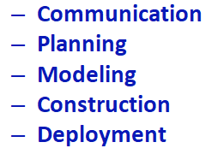
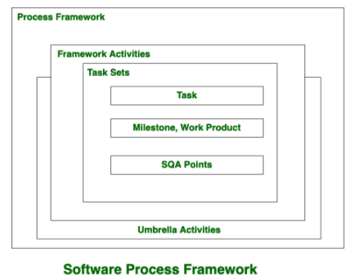
Generic Process Framework Activities
Five Generic Process Framework Activities

Slide 30
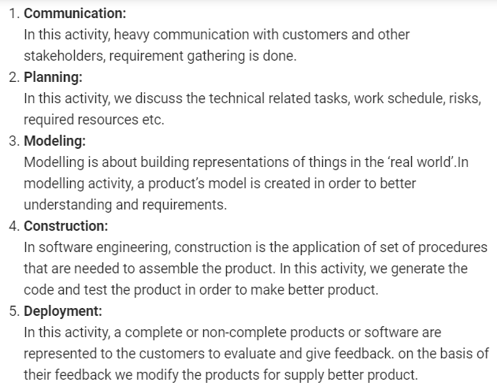
Generic Process Framework Activities

Slide 31

Basic Principles of Software Engineering
David Hookers – 7 Core Principles of Software Engineering / Underlying Laws / Assumptions
Principle 1: The Reason It All Exists
Principle 2 : KISS ( Keep it Simple , Stupid )
Principle 3 : Maintain the Vision
Principle 4 : What you Produce , Others will Consume
Principle 5 : Be Open to Future
Principle 6 : Plan Ahead for Reuse
Principle 7 : Think

Slide 32
Software Engineering Practices
The Essence of Practice - George Polya outlined the essence of software engineering practice:
Understand the problem (Communication and Analysis).
Plan a solution (Modeling and Software Design).
Carry out the plan (Code Generation).
Examine the result for accuracy (Testing and Quality Assurance)

Slide 33
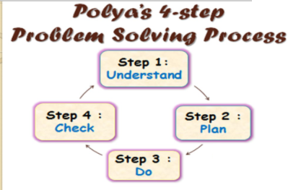
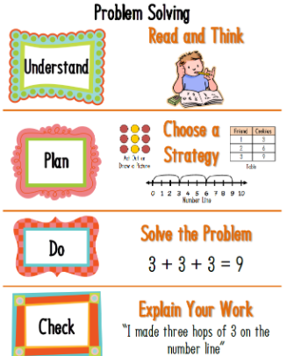
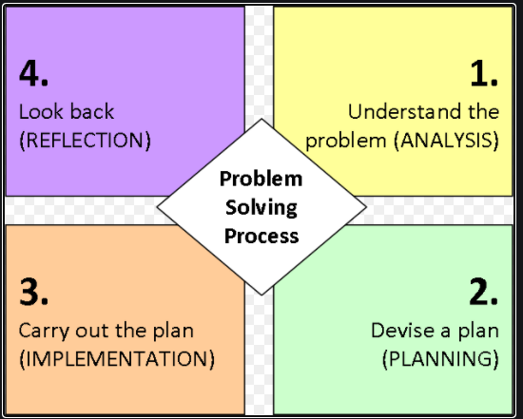
Polya’s – Software Engineering Best Practices

Slide 34
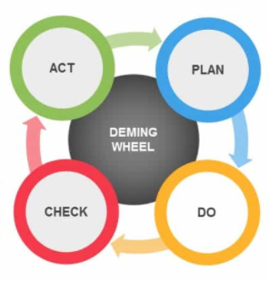
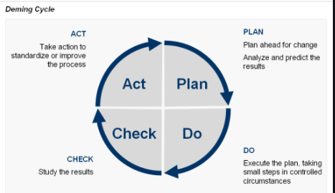
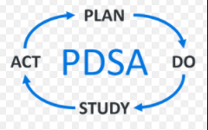
PDCA Cycle / PDSA Cycle / Deming Cycle
PDCA can be used as a problem solving approach and it is coined to Dr. W. Edwards Deming
The PDCA model is a Methodological approach to problem solving with an stress on assessing Feedback to improve quality of goods and services.
Rotating Circles representing the Iterative and Systematic Movements

Slide 35
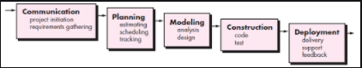
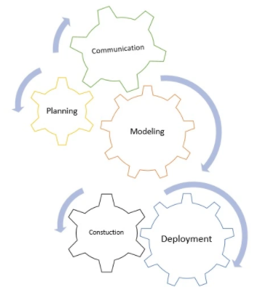
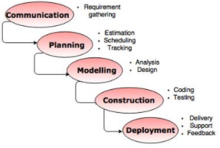
Software Process Framework Activities

Slide 36
Communication Principles
Listen
Prepare before you communicate
Facilitate the communication
Face-to-Face is best
Take Notes and Document Decisions
Collaborate with the customer
Stay focused (modularize your discussion)
Draw pictures when things are unclear
Move on … (when agreed, disagreed, or unclear)
Negotiation works best when both parties win.

Slide 37

Software Process Model / SDLC Models
Each Process Model follows a Series of Steps unique to its type to ensure success in the process of software development
There are many development life cycle models that have been developed in order to achieve different required objectives
Waterfall Model
Incremental Model
Iterative Model
Prototype Model
RAD Model
Spiral Model
V Model

Slide 38

Life Cycle Model
Different Life Cycle Models may map the basic Development Activities to phases in different ways.
No matter which life cycle model is followed, the basic activities are included in all life cycle models though the activities may be carried out in different orders in different life cycle models.
The Development Team must identify a suitable Life Cycle Model for the particular project and then adhere to it.

Slide 39

Need for a Software Life Cycle Model
Without using of a particular life cycle model the development of a software product would not be in a Systematic and Disciplined Manner. When a software product is being developed by a team there must be a clear understanding among team members about when and what to do. Otherwise it would lead to chaos and project failure.
This problem can be illustrated by using an Example.
Suppose a software development problem is divided into several parts and the parts are assigned to the team members. From then on, suppose the team members are allowed the freedom to develop the parts assigned to them in whatever way they like.
It is possible that one member might start writing the code for his part, another might decide to prepare the test documents first, and some other engineer might begin with the design phase of the parts assigned to him.

Slide 40
Need for a Software Life Cycle Model
Acceptance Criteria Document refers to a set of Predefined Requirements
Requirement Phase
A Software Life Cycle Model defines Entry and Exit Criteria for Every Phase. A phase can start only if its phase-entry criteria have been satisfied.
So without software life cycle model the entry and exit criteria for a phase cannot be recognized.
Design Phase
Requirement Phase
Exit Criteria
Entry Criteria
Design Phase

Slide 41

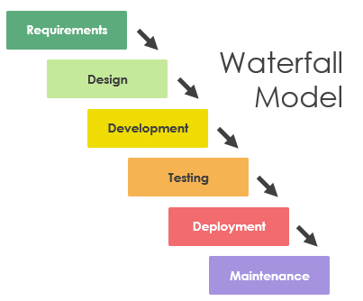
WaterFall Model – Traditional Model
The Waterfall Model is a breakdown of Project Activities into Linear Sequential Phases, where each phase depends on the deliverables of the previous phase and corresponds to a specialisation of tasks

Slide 42
Classical WaterFall Model
First introduced by Dr. Winston W. Royce in a paper published in 1970, the waterfall model is a software development process . WaterFall Model can be considered to be a Theoretical way of developing software.
All other life cycle models are essentially derived from the classical waterfall model.
The classical waterfall model is an idealistic one since it assumes that no development error is ever committed by the engineers during any of the lifecycle phases.
In practical development environments, the engineers do commit a large number of errors in almost every phase of the life cycle.

Slide 43
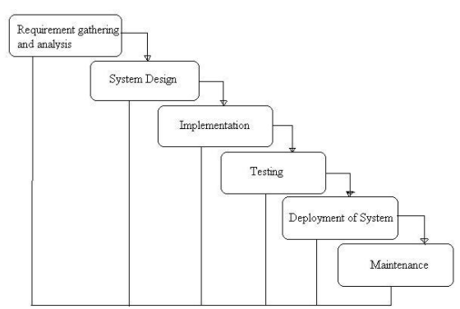
Modern WaterFall Model / FeedBack WaterFall Model

Slide 44
WHEN TO USE THE WATERFALL MODEL
This model is used only when the Requirements are very well known, clear and fixed.
Product Definition is stable and technology is understood.
The project duration is long.
In Waterfall model, very less customer interaction is involved during the development of the product.
Only when the product is ready then only it can be demonstrated to the end users.
Once the product is developed and if any failure occurs then the cost of fixing such issues are very high, because we need to update everything from document till the logic.

Slide 45
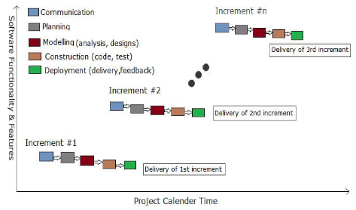
Incremental Model
In Incremental Model the whole requirement is divided into various Modules.
Multiple development cycles take place here, making the life cycle a “multi-waterfall” cycle.
-Cycles are divided up into smaller, more easily managed modules.

Slide 46
Incremental Model
An Incremental Model combines the elements of the waterfall model in an iterative manner.
It delivers a series of releases called “increments” that provide progressively more functionality for the client as each increment is delivered.
Waterfall model is repeatedly applied in each increment.

Slide 47
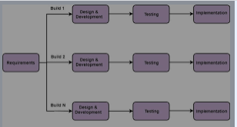
Incremental Model
A working version of software is produced during the first module, so you have working software early on during the software life cycle.
Each subsequent release of the module adds function to the previous release. The process continues till the complete system is achieved.
The product is defined as finished when it satisfies all of its requirements

Slide 48

Increment Model
The First increment is often a core product where the necessary requirements are addressed, and the extra features are added in the next increments.
The core product is used and evaluated by the client.
Once the customer assesses the core product, there is plan development for the next increment.
Thus, in every increment, the needs of the client are kept in mind, and more features and functions are added, and the core product is updated. This process continues until the complete product is produced.
The increments earlier to the main increment is called as “stripped down” versions of the final product. These increases form a base for customer evaluation. On this basis, the client can suggest new requirements if required.

Slide 49
WHEN TO USE THE INCREMENTAL MODEL
This model can be used when the requirements of the complete system are clearly defined and understood.
Major requirements must be defined, however, some details can evolve with time.
There is a need to get a product to the market early.
A new technology is being used
Resources with needed skill set are not available

Slide 50

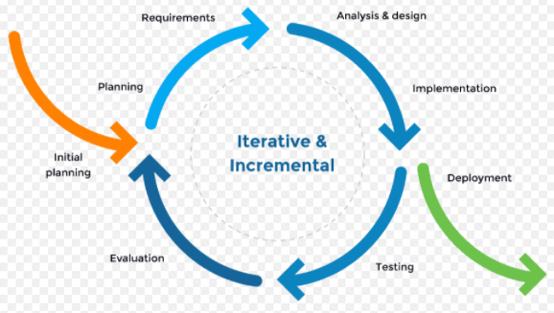
Iterative Model
5 Cycles of the Iterative Model of SDLC
Planning and Requirements
Analysis and Design
Implementation
Testing
Evaluation

Slide 51
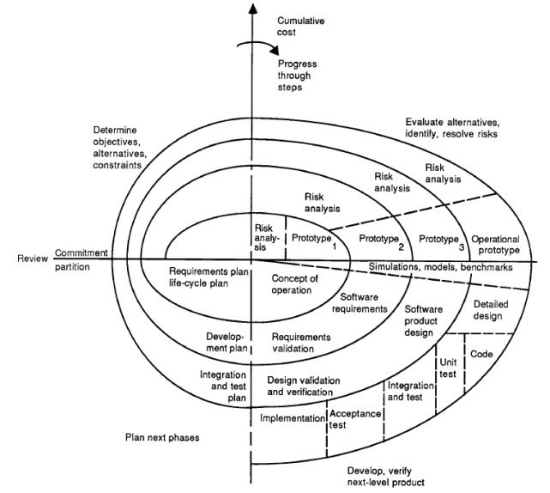
Spiral Model / Risk Analysis Model

Slide 52
Spiral Model
The Spiral Model of Software Development and Evolution represents a Risk Driven Approach to Software Process Analysis and Structuring (Boehm 1987, Boehm et al, 1998).
This approach, Developed by Barry Boehm
It represents an Iterative Development Cycles as an Expanding Spiral, with Inner Cycles denoting early system analysis and prototyping, and Outer Cycles denoting the classic software life cycle
The Radial Dimension denotes Cumulative Development Costs, and the Angular Dimension denotes progress made in accomplishing each development spiral

Slide 53

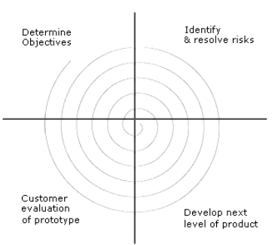
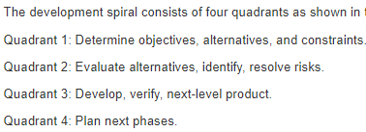
Risk Analysis Model / Meta Model
Risk Analysis, which seeks to identify situations that might cause a development effort to fail or go over budget / schedule, occurs during each spiral cycle
Displaced Sweep denotes increasing levels of effort required for risk analysis
Model appears like a spiral with many loops.
The exact number of loops in the spiral is not fixed.
The Spiral Model is called a Meta Model since it encompasses all other life cycle models.

Slide 54
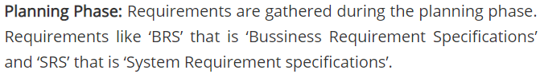
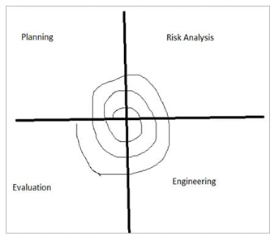
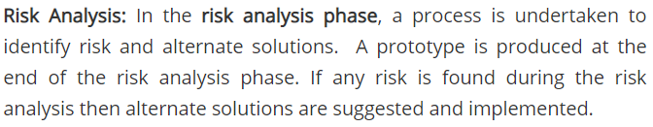
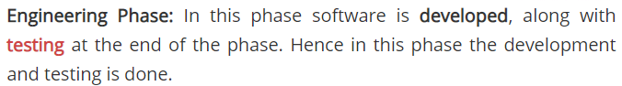
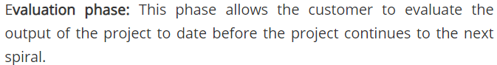
4 Phases of Spiral Model
The Spiral Model has Four Phases:
Planning,
Risk Analysis,
Engineering &
Evaluation.

Slide 55
When to use Spiral Methodology?
When releases are required to be frequent.
When creation of a prototype is applicable.
When risk and costs evaluation is important.
For medium to high-risk projects.
When requirements are unclear and complex.
When changes may require at any time.
Risk Analysis requires highly specific expertise. Project's success is highly dependent on the risk analysis phase. Doesn't work well for smaller projects.
Favored for Large, Expensive and Complicated Projects

Slide 56
Prototype Model
Software Prototyping is the activity of creating prototypes of software applications
The Prototyping Model is a systems development method in which a prototype is built, tested and then reworked as necessary until an acceptable outcome is achieved from which the complete system or product can be developed
Prototype model should be used when the desired system needs to have a lot of interaction with the end users

Slide 57
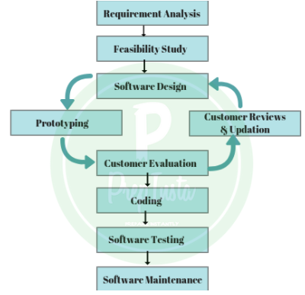
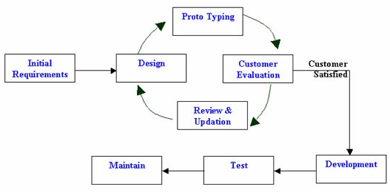
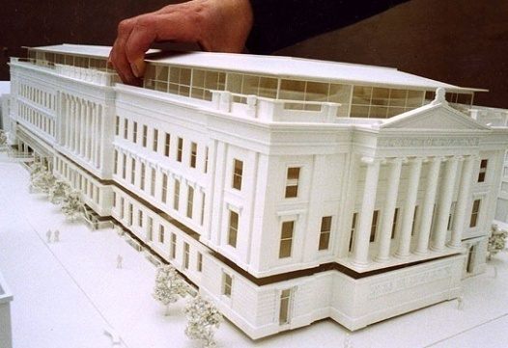
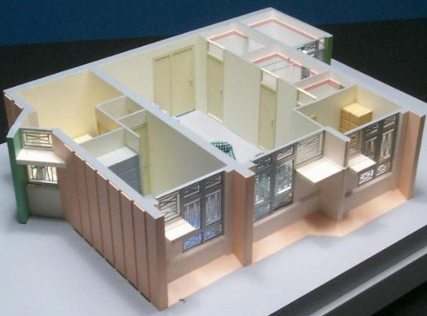
Prototype Model
“ A Prototype is worth a Thousand Words”
A Prototype is a Basic Working Model, Mock-up or a Simple Simulation of the Product
The main reason for prototyping is to validate the idea and this is the step in converting an idea to a real product

Slide 58
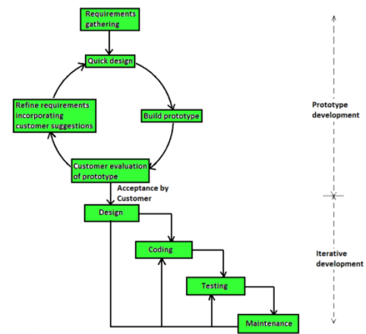
Prototype Model

Slide 59
Types of Prototype Model
Paper Pencil Prototype
GUI Prototype ( User Interface Prototype)
Throw – Away Prototype
Evolutionary Prototype
Horizontal Prototype
Vertical Prototype

Slide 60
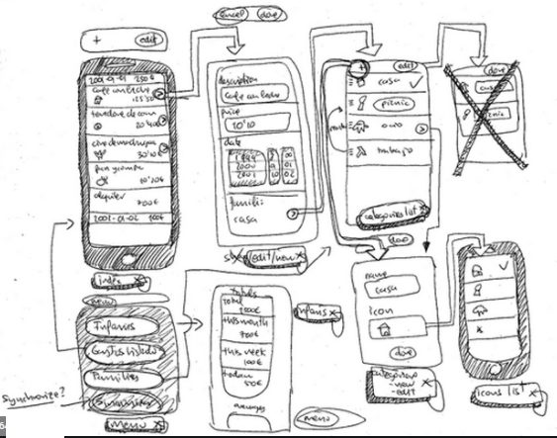
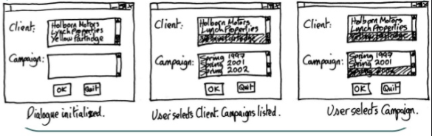
Paper Pencil Prototype

Slide 61
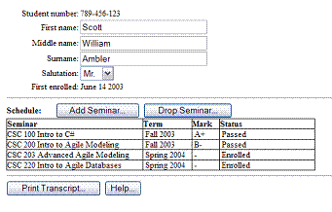
GUI Prototype

Slide 62
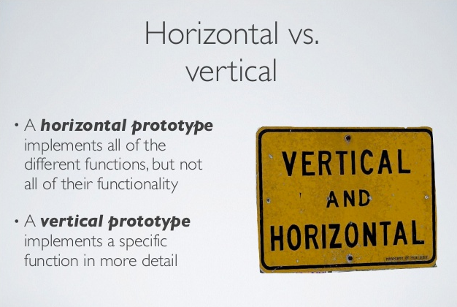
Horizontal / Vertical Prototype

Slide 63
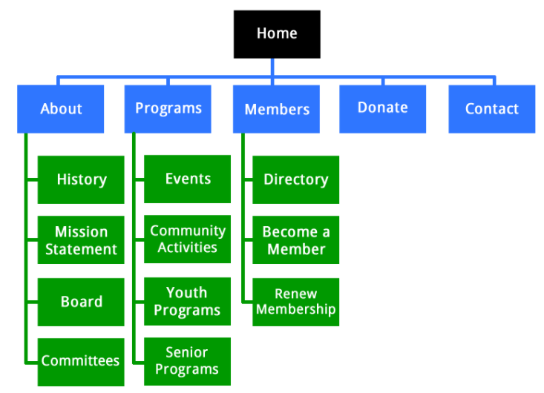
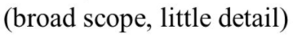
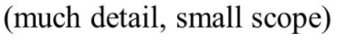
Horizontal / Vertical Prototype
Horizontal Prototype
Vertical Prototype

Slide 64

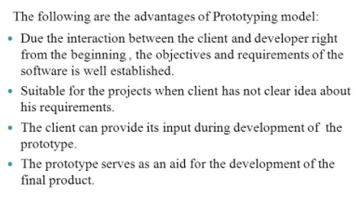
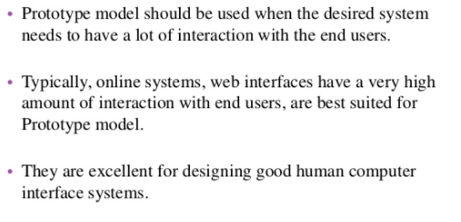
Where to use Prototype Model

Slide 65
RAD Process Model
In RAD Model the Components or Functions are developed in Parallel as if they were Mini Projects.
The Developments are Developed, Delivered and then Assembled into a Working Prototype.
This can quickly give the customer something to see and use and to provide feedback regarding the delivery and their requirements
Module A
Components

Slide 66

RAD Process Model

Slide 67

Rapid Application Development Model

Slide 68
Advantage of RAD Model
This model is Flexible for Change.
In this model, Changes are Adoptable.
It Reduced - Development Time.
It increases the Reusability of Features.
When the System should need to create the project that modularizes in a Short Span Time (2-3 months).
When the requirements are well-known.
When the technical risk is limited.

Slide 69

V-Model ( V&V Model) – Verification & Validation Model
Non- Execut
ion
Based
Test
ing
Execut
ion
Based
Test
ing
Static
Testing
Dynamic
Test
ing

Slide 70
Maturity Models for Process Improvement
Software Process Improvement Model
CMM - Capability Maturity Model (CMM)
(CMM) is a Software Process Improvement Methodology used to Develop and Refine an organization's Software Development Process.
CMM was Developed and is Promoted by the Software Engineering Institute (SEI), a Research and Development Center sponsored by the U.S. Department of Defense (DoD).

Slide 71
History of Maturity Model
A Maturity Model is a tool that helps people assess the current effectiveness of a person or group and supports figuring out what capabilities they need to acquire next in order to improve their performance
Capability Maturity Model (CMM) is a Development Model created in 1986
The CMM was originally developed as a tool for objectively assessing the ability of government contractors' processes to implement a contracted software project.

Slide 72
Need for Maturity Model
The Model is based on the Process Maturity Framework first Published in 1989 in the book ”Managing the Software Process” by Watts Humphrey.
In 1980’s, several US military projects involving software subcontractors ran over-budget and were completed far later than planned. In an effort to determine why this was occurring, the United States Air Force funded a study at the Software Engineering Institute (SEI).
Active development of the model by the US Department of Defense Software Engineering Institute (SEI) began in 1986 when Humphrey joined the Software Engineering Institute located at Carnegie Mellon University in Pittsburgh, Pennsylvania
At the request of the U.S. Air Force he began formalizing his Process Maturity Framework to aid the U.S. Department of Defense in evaluating the capability of software contractors as part of awarding contracts
The full representation of the Capability Maturity Model as a set of defined Process Areas and Practices at each of the Five Maturity Levels was initiated in 1991

Slide 73

Internal Structure of Maturity Level

Slide 74

Five Levels of Software Process Maturity
CMM Follows a Stage - Architecture for Process Improvement Model
It contains Stages / Levels through which an organization process evolves from one that is Adhoc & UnManaged to one that is Repeatable , Defined , Managed and Optimized

Slide 75

Key Process Areas of CMM

Slide 76
Structure of Levels - CMM
Each Level with the Exception of Level 1 has a structure that consists of the following
A Set of Maturity Goals ( KPA’s )
Supporting Maturity SubGoals
Activities , Tasks and Responsibilities ( ATR’s)
Level 1 : ( No Maturity Goals ) : Initial
Process at this level is ill- Defined , Ad hoc , Uncontrolled & Reactive Manner
A Documented set of Specification for Software Behaviour Often does not Exist.
Software Products are often Released without any Quality Assurance
There is a Lack of Resources , Tools and Properly Trained Staff.

Slide 77
CMM : Level2 :Repeatable
Level2:Repeatable: This Maturity Level is best Focused on Project Level Thinking.
Basic Project Management Processes are in place to track the Cost, Schedule, Functionality, and Quality of the product.
Lessons learned from previous similar projects are applied.
There is a scense of Descipline. Basic software testing practices, such as test plans and test cases are used

Slide 78
CMM : Level3: Defined
Level 3: Defined
Common Management and Engineering Activities are Standardized and Documented.
These Standards are Adapted and Approved for use on different projects.
Test Documents and Plans are Reviewed and Approved before testing begins.
The Test Group is Independent form Developers. The Test Results are used to determine when the s/w is ready.

Slide 79
CMM : Level 4: Managed
Level 4: Managed: At this maturity level, the organizations process is under statistical control.
Product Quality is specified Quantitatively beforehand (For Example, this product wont release until it has fewer than 0.5 defects per 1,000 lines of code) and the s/w isn't released until that goal is met.
Details of the Development Process and the S/w Quality are collected over the projects development, and adjustments are made to correct deviations and to keep the project on plan.

Slide 80
CMM : Level 5 : Optimizing
Level 5 : Optimizing This Level is called “Optimizing“ (not “Optimized“ ) because it's Continually Improving from Level 4.
New Technologies and Processes are Attempted, the results are Measured, and both Incremental and Revolutionary Changes are instituted to achieve even better quality

Slide 81





GAP Analysis in CMM
Level 3
Level 2

Slide 82

System Engineering
Before S/w can be Engineered, the “System” in which it Resides must be Understood

Slide 83
Computer Based System
A Set of Arrangement of Elements that are Organized to accomplish some Predefined Goal by Processing Information
Element of Computer Based System are :
Software
Hardware
People
Database
Documentation
Procedures

Slide 84
System Engineering Hierarchy

Slide 85
View’s - System Engineering Hierarchy
The Process usually Begins with a “World View” ➔ the entire Business or Product Domain
The World View is Refined to focus more fully on Specific Domain of interest
The Need for Targeted System Element (with in specific domain) is Analyzed
Then Analysis, Design, Construction of Targeted System Element is Initiated

Slide 86
Agile Model
Why Agile?
Technology in this Current Era is Progressing Faster than Ever, enforcing the Global Software Companies to work in a Fast-Paced Changing Environment. ( We are in the World of Fast Changing Business Requirement....)
Because these Businesses are Operating in an Ever-Changing Environment, it is impossible to gather a complete and exhaustive set of Software Requirements
As a consequence, a conventional software development model fails to deliver the required product

Slide 87
Agile Methodology
Customer Satisfaction through Early and Continuous Software Delivery – Customers are Happier when they receive Working Software at regular intervals, rather than waiting extended periods of time between releases.
The Agile Manifesto and the Twelve Principles of Agile Software were the consequences of Industry Frustration in the 1990’s.
The Enormous Time Lag between Business Requirements (the Applications and Features customers were Requesting) and the Delivery of Software that answered those Needs, led to the cancelling of many projects

Slide 88
History of Agile Model
Business Requirements and Customer Requisites Changed during this Lag Time, and the Final Product did not meet the then Current Needs.
The Software Development Models available, did not meet the demand for speed and did not take advantage of just how quickly software could be altered.
In 2000, a Group of Seventeen “Thought Leaders” including Jon Kern, Kent Beck, Ward Cunningham, Arie van Bennekum, and Alistair Cockburn, met where they Published the Agile Manifesto and the Twelve Principles of Agile Development.

Slide 89

Four Values of The Agile Manifesto
The Agile Manifesto is comprised of 4 Foundational Values and 12 Supporting Principles which lead the Agile Approach to Software Development.
Individuals and Interactions Over Processes and Tools
Working Software Over Comprehensive Documentation
Customer Collaboration Over Contract Negotiation
Responding to Change Over Following a Plan
https://www.geeksforgeeks.org/software-engineering-agile-software-development/

Slide 90
Other Specialized Software Developement Models
Rapid Application Development (RAD) - 1991
The Unified Process (UP) and Dynamic Systems Development Method (DSDM) - Both from 1994
Scrum from 1995
Crystal Clear and eXtreme Programming (XP) - Both from 1996
Feature-Driven Development - 1997
Agile Development - 2001

Slide 91


Agile Process
Scrum ( Rugby )

Slide 92




Scrum Implementation of Agile
A Process is broken down into Smaller Pieces.
Firstly, we do just enough Planning to get started with buliding with the Minimum Features
We Build those Planned
Next we Test & Review the small fetaure set and get it ready to Ship.
------------------------------------------------------------------------------------------------------------------------------------------------------------------------
When that Cycle is Completed , we end up with a Potentially Shippable Work Product
This Process Usually Occurs in a Time peroid of 1- 3 weeks.
This is repeated Time & Time again – Reducing the time from Planning , Development , Testing & Review
------------------------------------------------------------------------------------------------------------------
We try to reduce the time between the Incremental Releases.
We end up with several Incremenral Releases called as Sprints.
------------------------------------------------------------------------------------------------------------------
Sprints Usually takes from 1- 3 weeks
We keep Repeating these Sprints Until our Product is Feature Complete
Sometime we may endup shipping the Product with Second Sprint / Third Sprint / Fourth Sprint... But we Always endup with Shipping an Working Product

Slide 93


